Slide 1
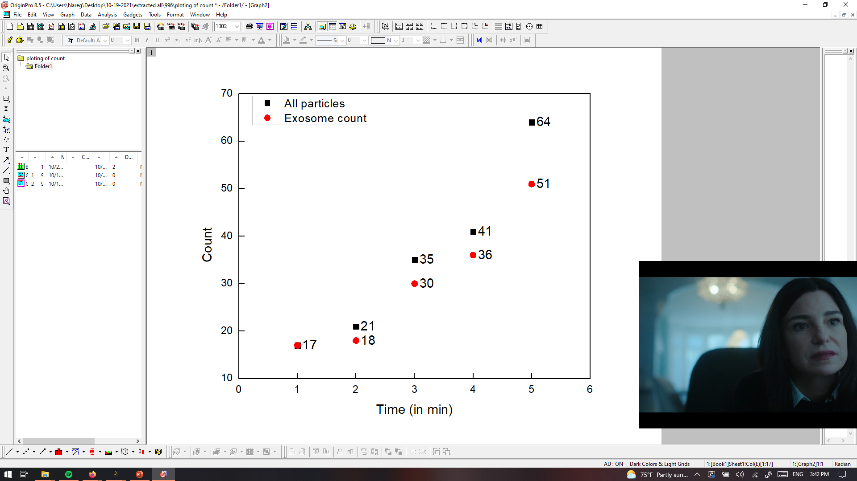
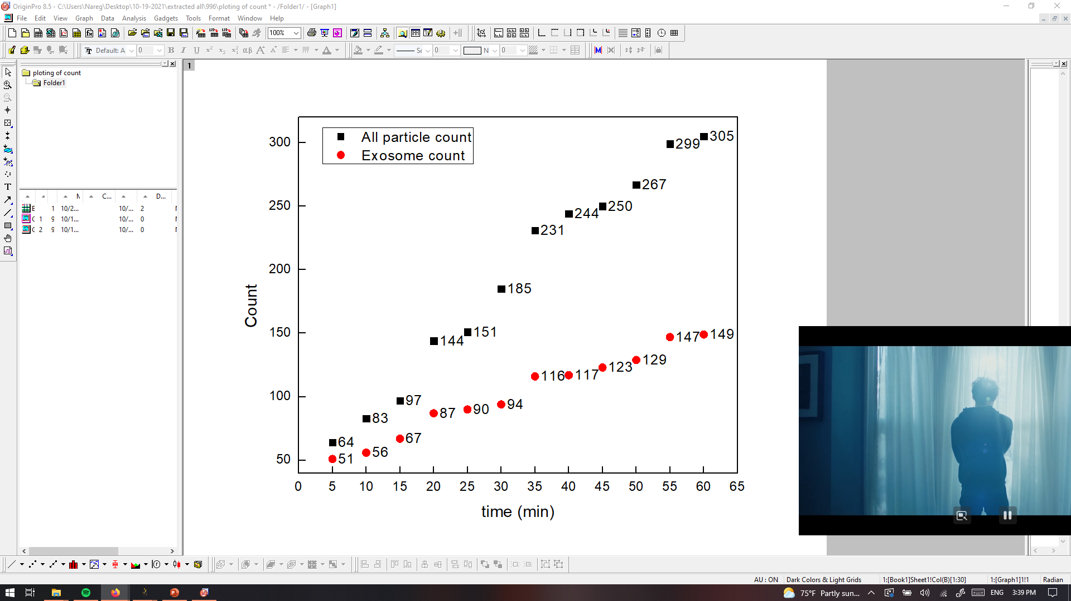
PANRORAMA of Plasma Sample Y=996? (Prediction Cancer)
Time: 10 min
Time: 20 min
Time: 30 min
Particle count at 5 min intervals
Time: 40 min
Time: 50 min
Time: 60 min
Scale bar: 10 µm

Slide 2

PANRORAMA of Plasma Sample Y=996? (Prediction Cancer)
Time: 60 min
Count: 305
Time: 60 min wash
Count: 136
Note: No response to miRNA-21 mb
Scale bar: 10 µm

Slide 3
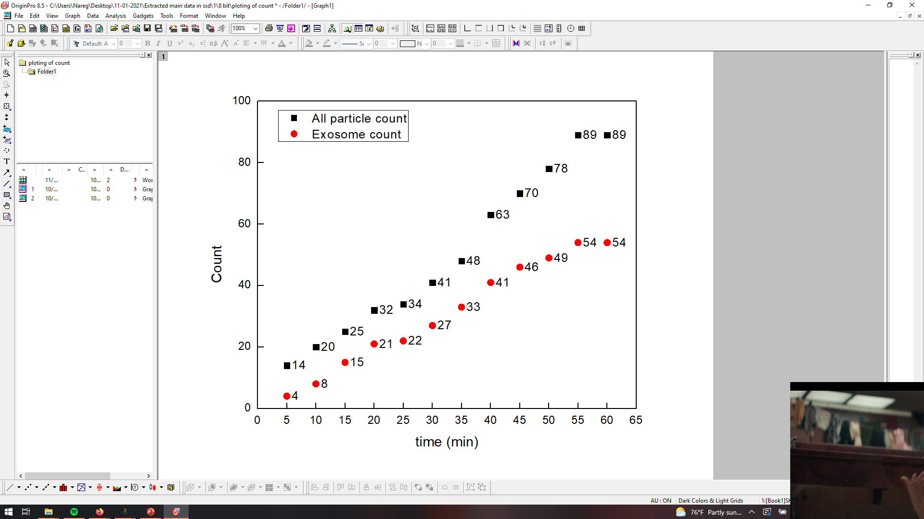
PANRORAMA of Plasma Sample 1 (Healthy)
Time: 10 min
Time: 20 min
Time: 30 min
Particle count at 5 min intervals
Time: 40 min
Time: 50 min
Time: 60 min
Scale bar: 10 µm

Slide 4

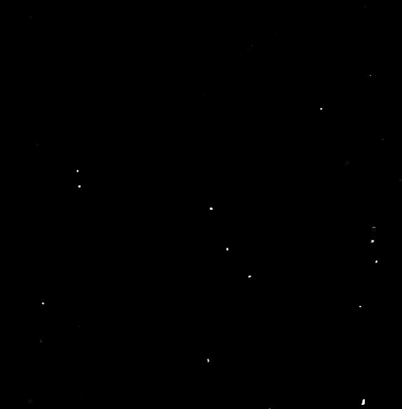
PANRORAMA of Plasma Sample 1 (healthy)
Time: 60 min
Count: 89
Time: 60 min wash
Count: 18
Note: No response to miRNA-21 mb
Scale bar: 10 µm

Slide 5
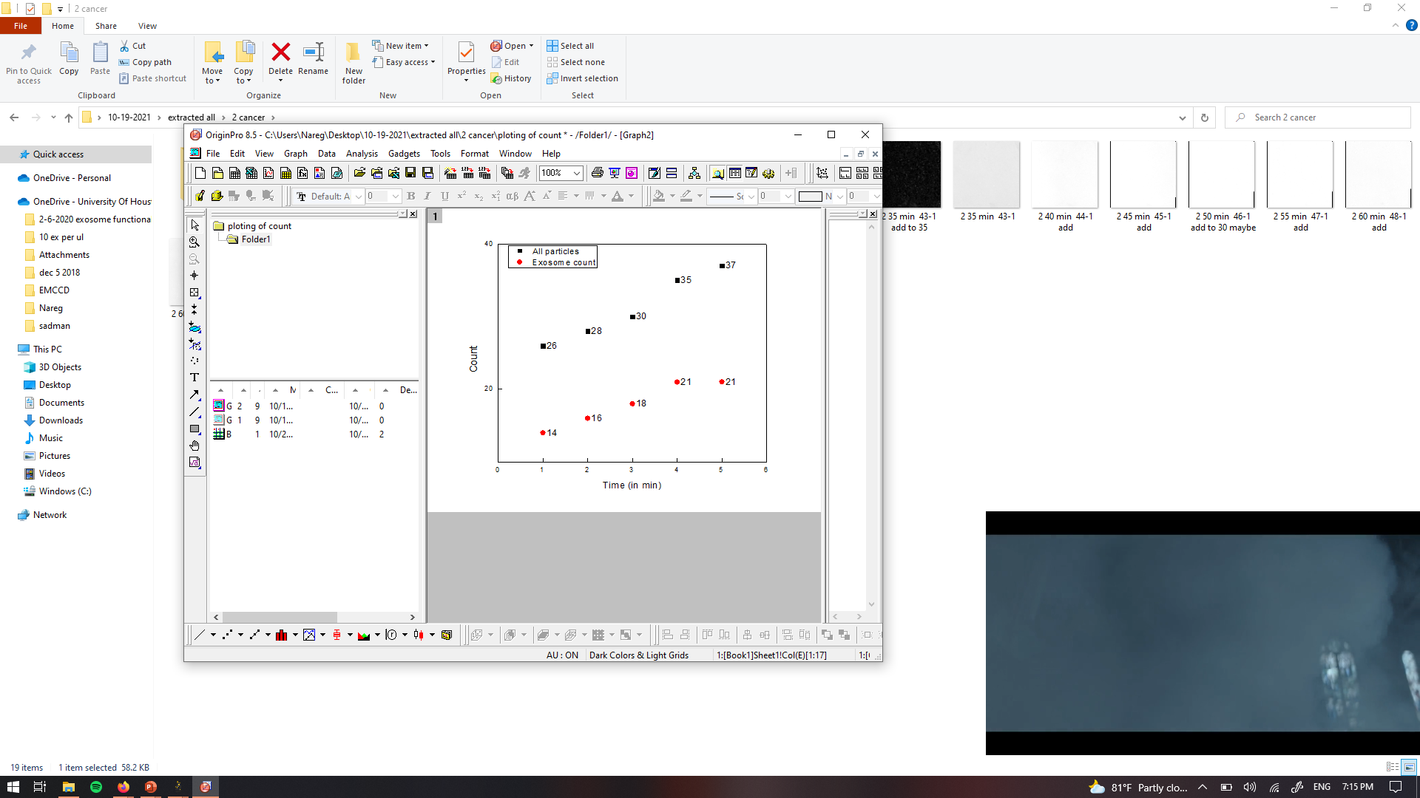
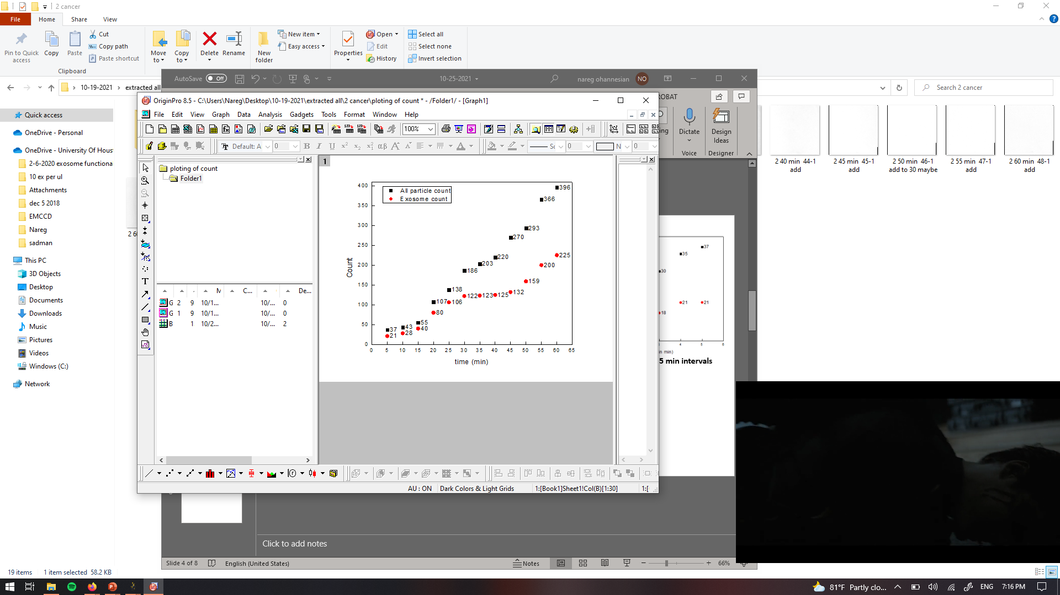
PANRORAMA of Plasma Sample 2 (Cancer)
Time: 10 min
Time: 20 min
Time: 30 min
Particle count at 5 min intervals
Time: 40 min
Time: 50 min
Time: 60 min
Scale bar: 10 µm

Slide 6


PANRORAMA of Plasma Sample 2 (Cancer)
Time: 60 min
Count: 396
Time: 60 min wash
Count: 105
Note: No response to miRNA-21 mb
Scale bar: 10 µm

Slide 7
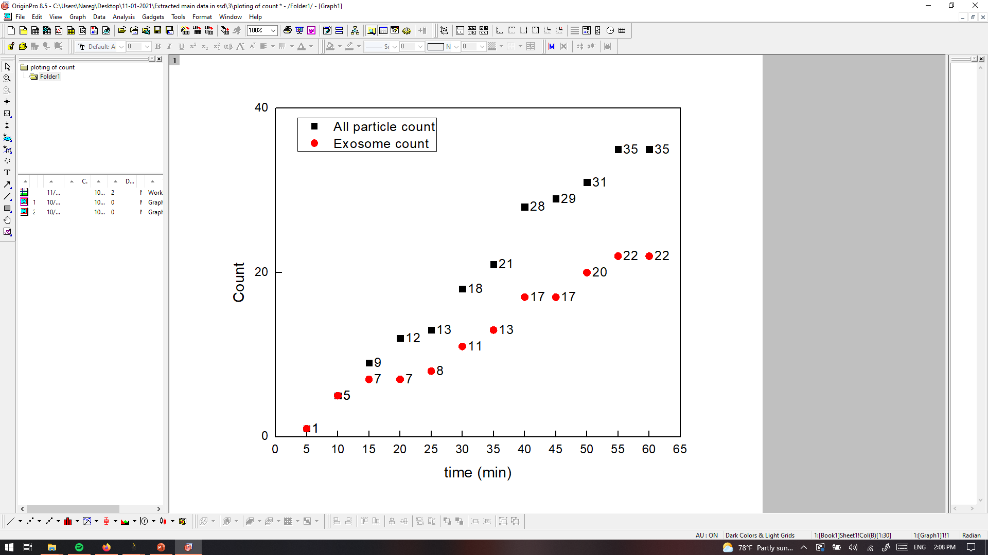
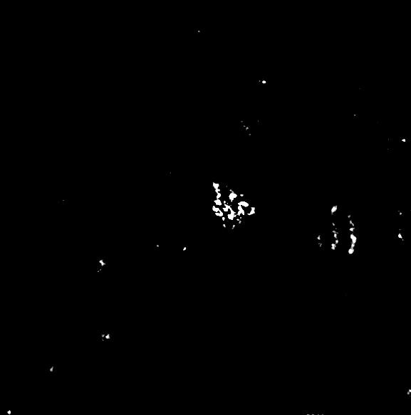

PANRORAMA of Plasma Sample 3 (healthy??)
Time: 60 min
Count: 35
Time: 60 min wash
Count: 7
Note: No response to miRNA-21 mb
Scale bar: 10 µm

Slide 8
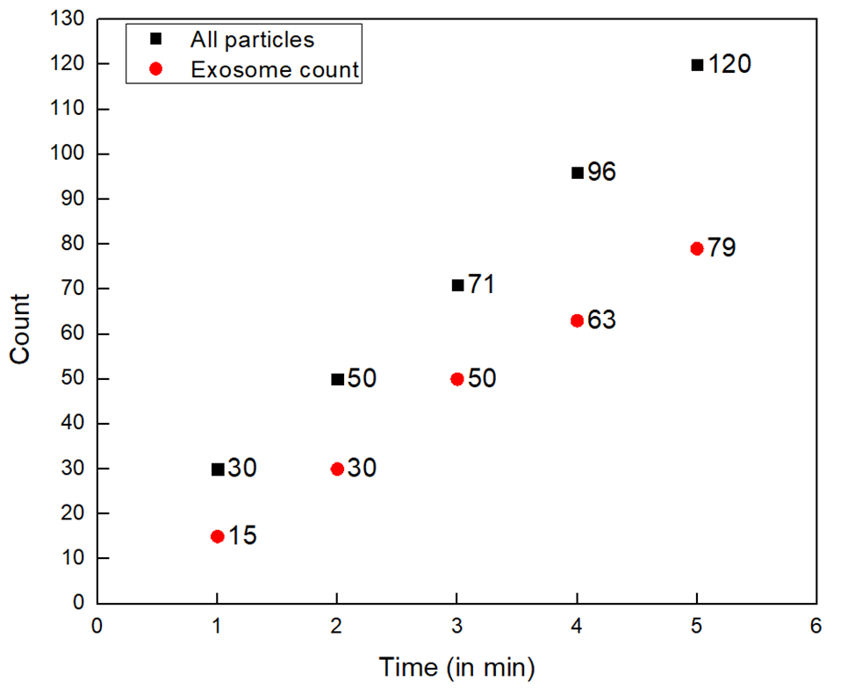
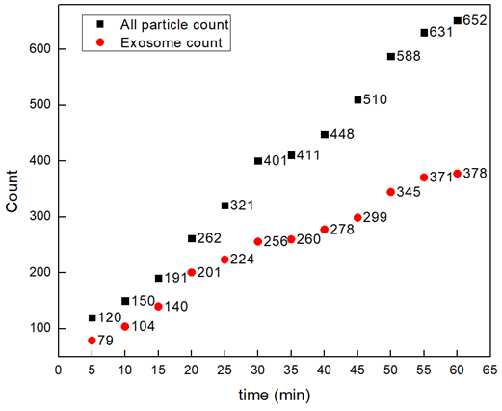
PANRORAMA of Plasma Sample 4 (Cancer)
Time: 10 min
Time: 20 min
Time: 30 min
Particle count at 5 min intervals
Time: 40 min
Time: 50 min
Time: 60 min
Scale bar: 10 µm

Slide 9

PANRORAMA of Plasma Sample 4 (Cancer)
Time: 60 min
Count: 652
Time: 60 min wash
Count: 201
Note: No response to miRNA-21 mb
Scale bar: 10 µm

Slide 10
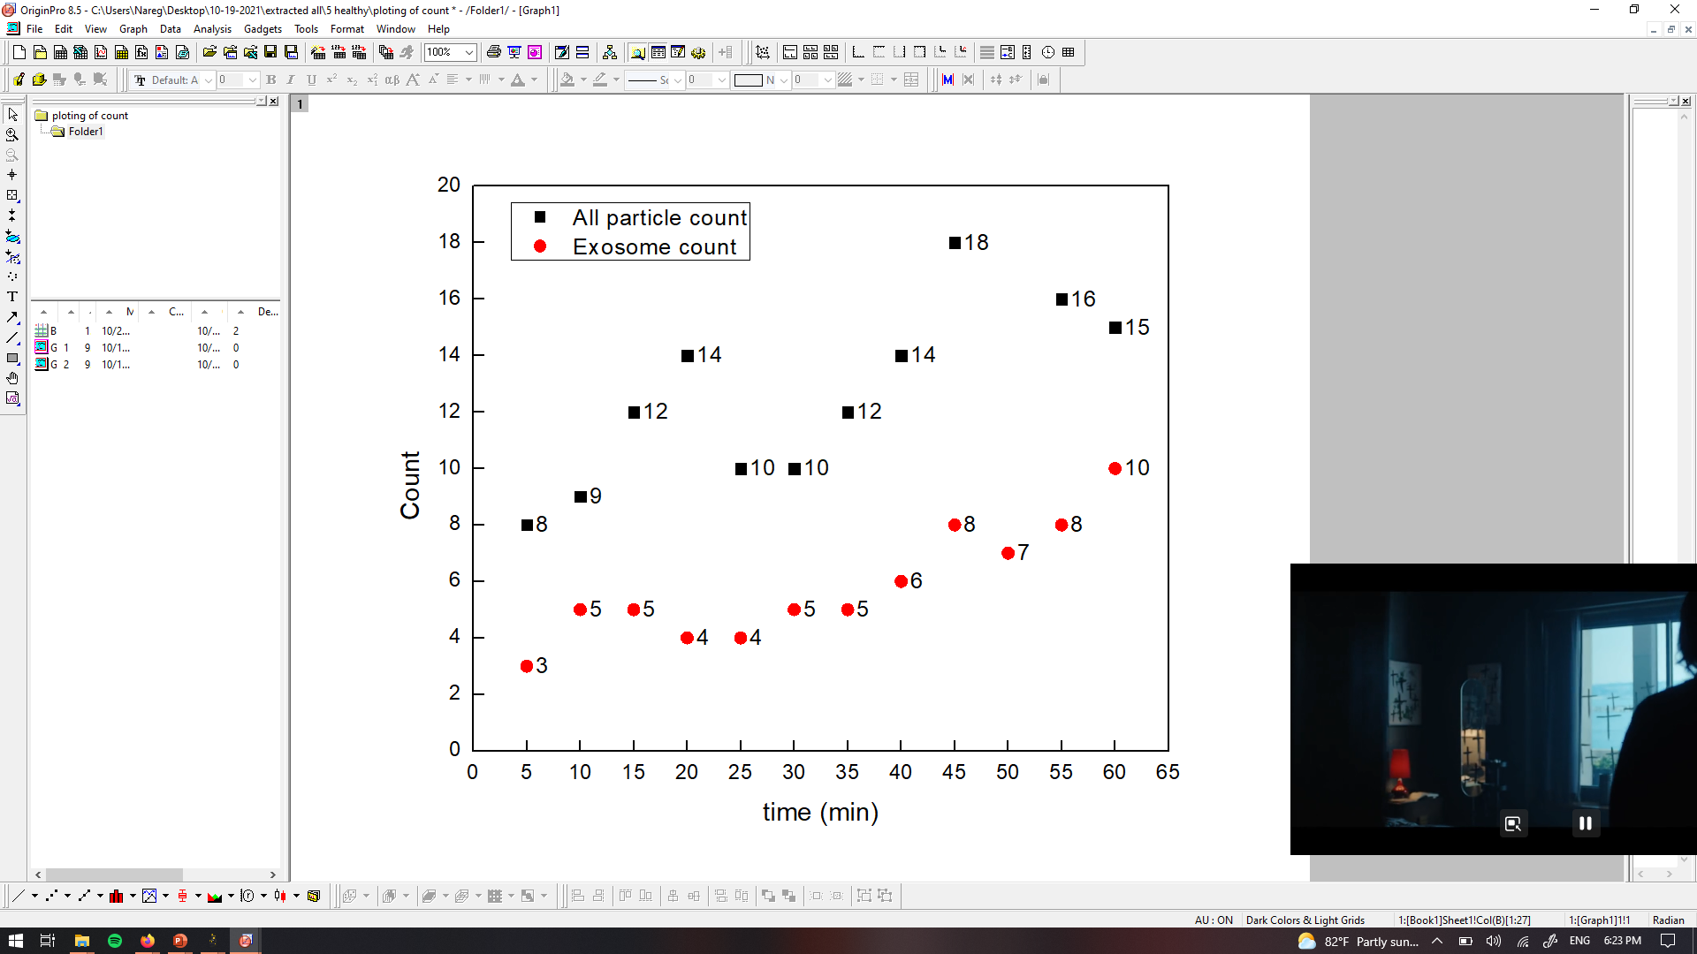
PANRORAMA of Plasma Sample 5 (Healthy)
Time: 60 min
Count: 15
Time: 60 min wash
Count: 5
Note: No response to miRNA-21 mb
Scale bar: 10 µm

Slide 11



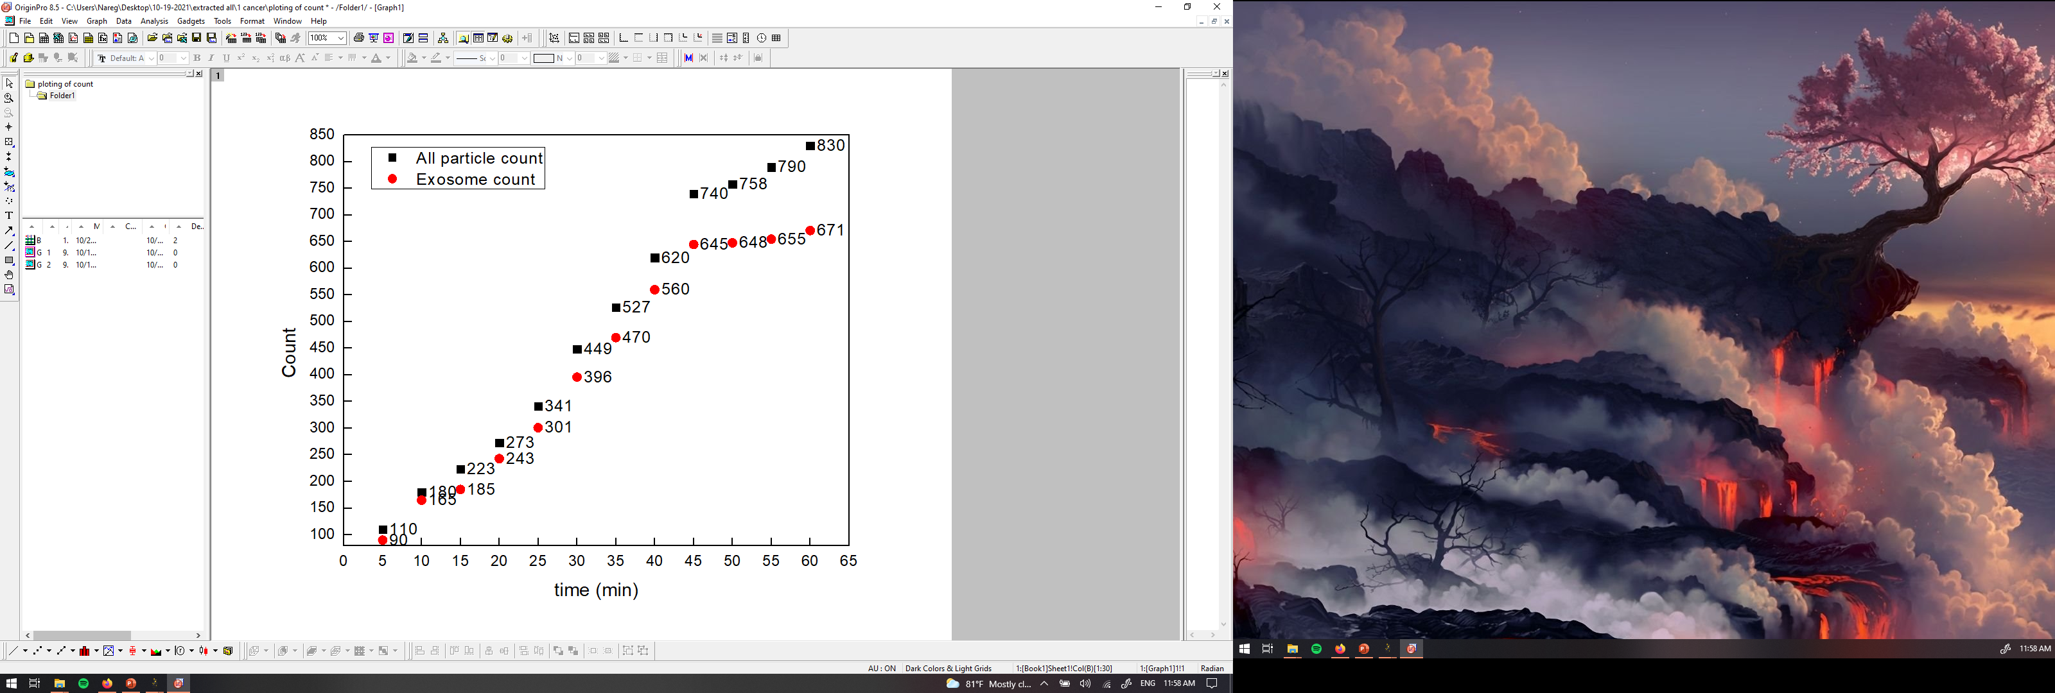


PANRORAMA of Plasma Sample 6 (Cancer)
Time: 10 min
Time: 20 min
Time: 30 min
Particle count at 5 min intervals
Time: 40 min
Time: 50 min
Time: 60 min
Scale bar: 10 µm

Slide 12


PANRORAMA of Plasma Sample 6 (Cancer)
Time: 60 min
Count: 830
Time: 60 min wash
Count: 404
Note: No response to miRNA-21 mb
Scale bar: 10 µm

Slide 13

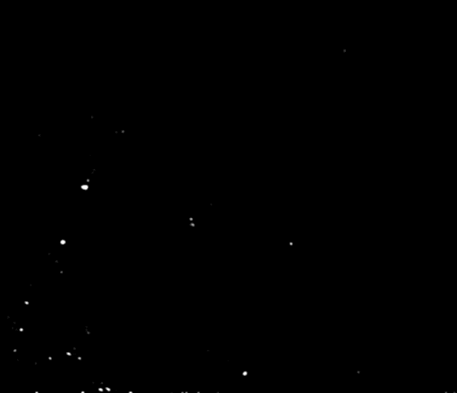
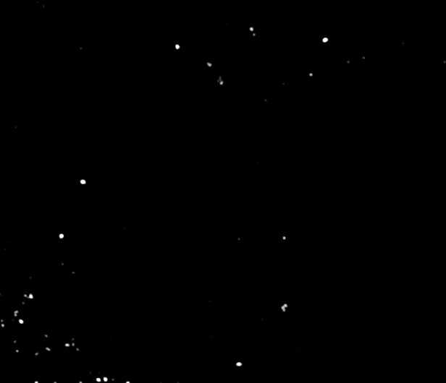
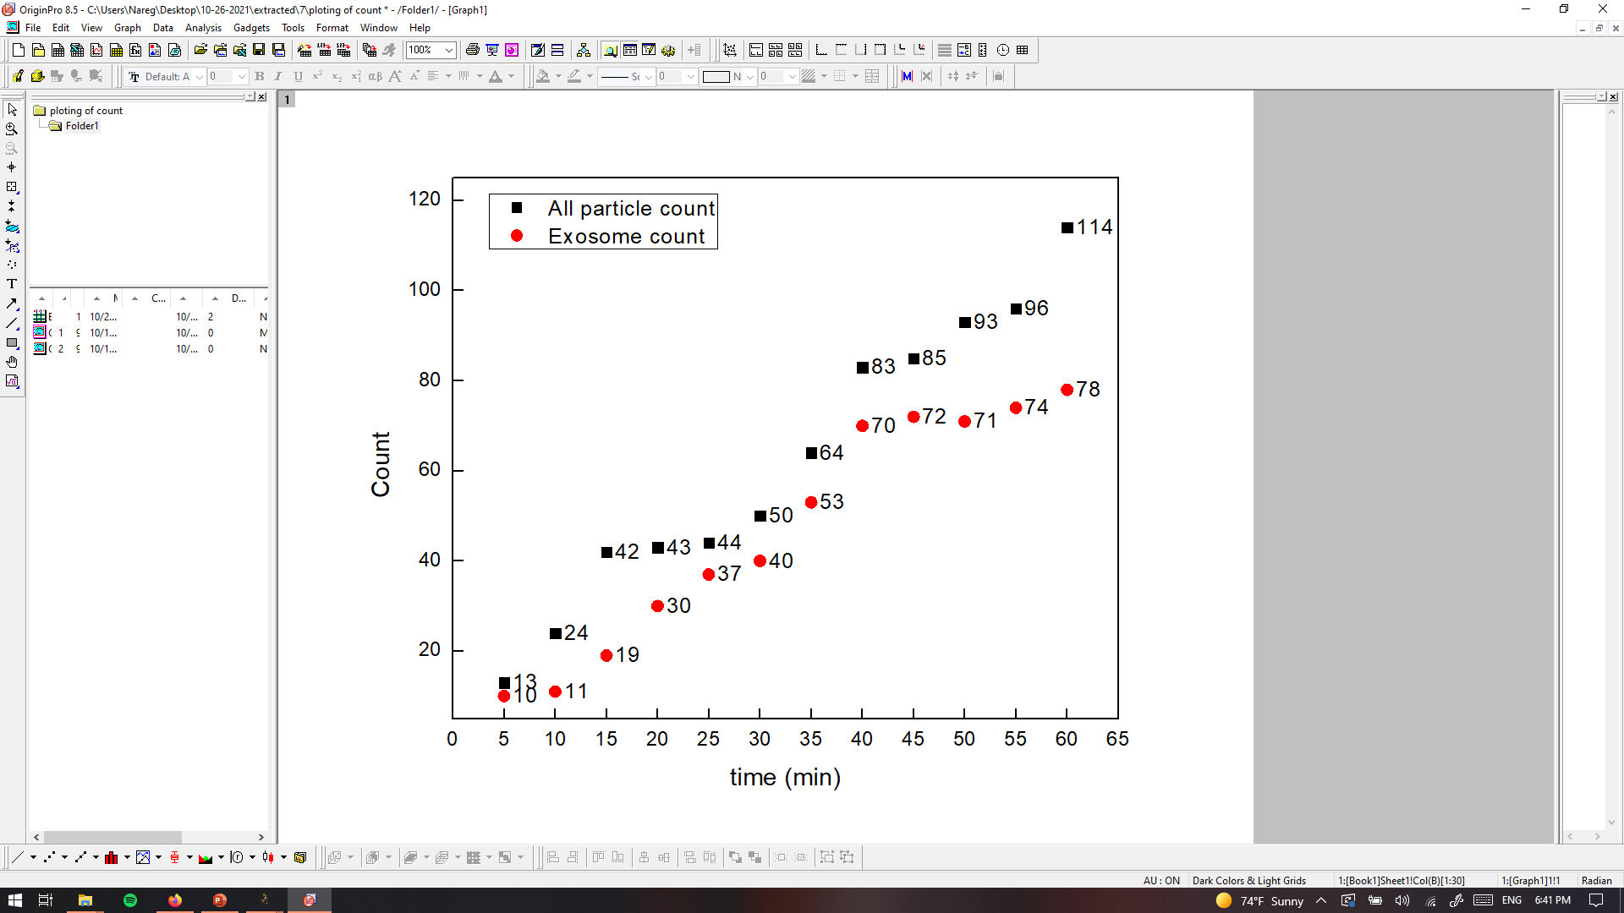
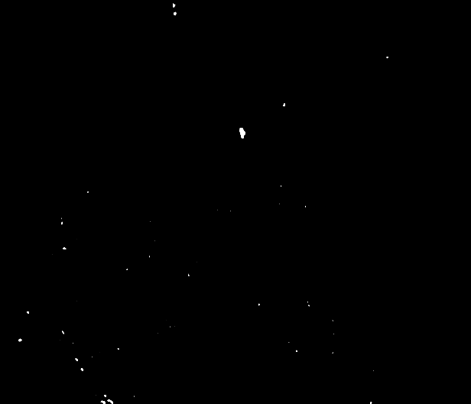
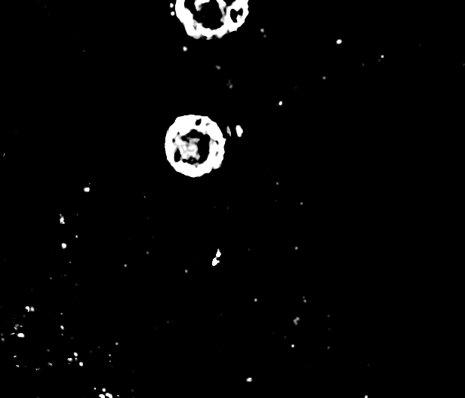
PANRORAMA of Plasma Sample 7 (Healthy)
Time: 10 min
Time: 20 min
Time: 30 min
Particle count at 5 min intervals
Time: 40 min
Time: 50 min
Time: 60 min
Scale bar: 10 µm

Slide 14

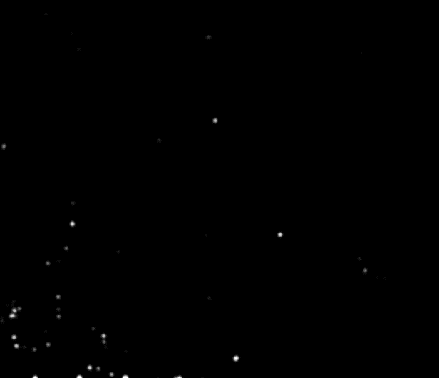
PANRORAMA of Plasma Sample 7 (Healthy)
Time: 60 min
Count: 114
Time: 60 min wash
Count: 33
Note: No response to miRNA-21 mb
Scale bar: 10 µm

Slide 15
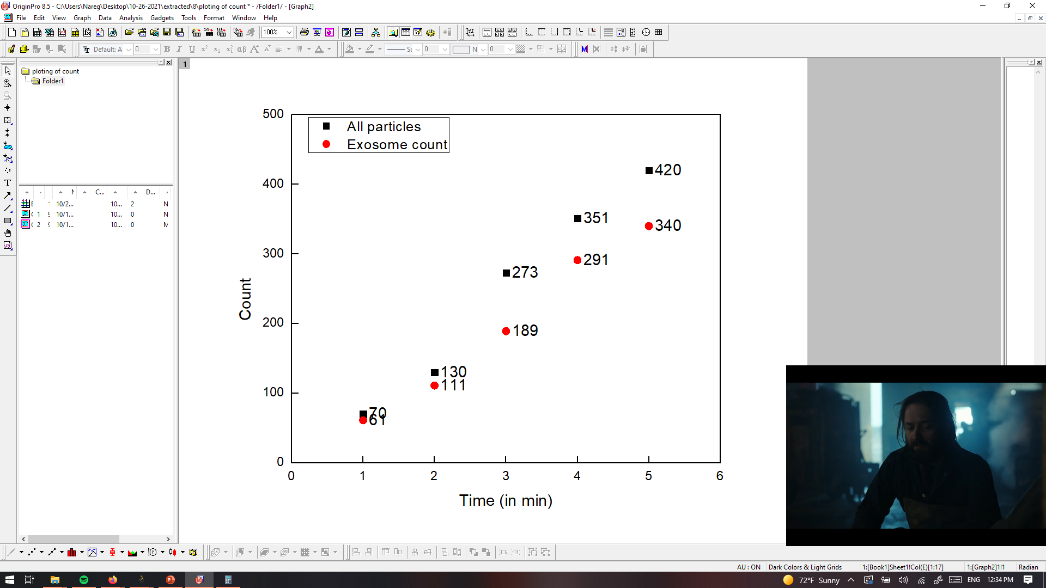
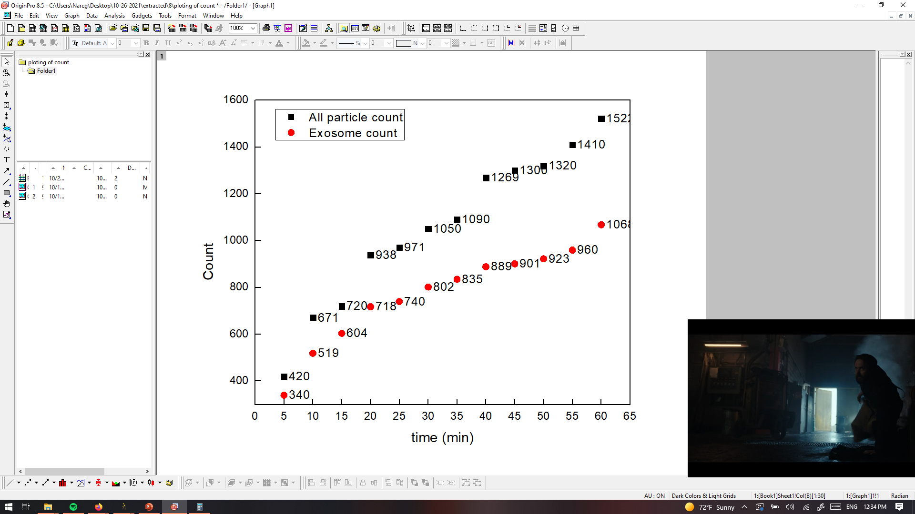
PANRORAMA of Plasma Sample 8 (Cancer)
Time: 10 min
Time: 20 min
Time: 30 min
Particle count at 5 min intervals
Time: 40 min
Time: 50 min
Time: 60 min
Scale bar: 10 µm

Slide 16
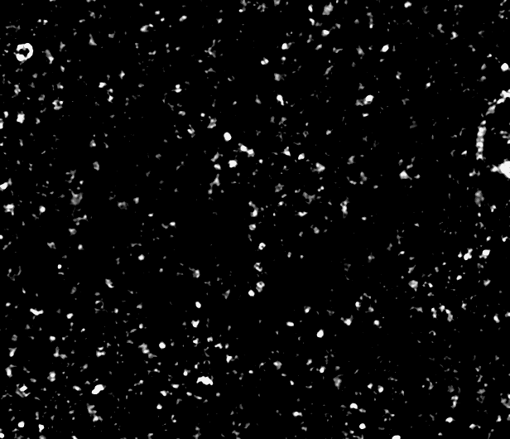

PANRORAMA of Plasma Sample 8 (Cancer)
Time: 60 min
Count: 1522
Time: 60 min wash
Count: 302
Note: 8% response to miRNA-21 mb
Scale bar: 10 µm

Slide 17
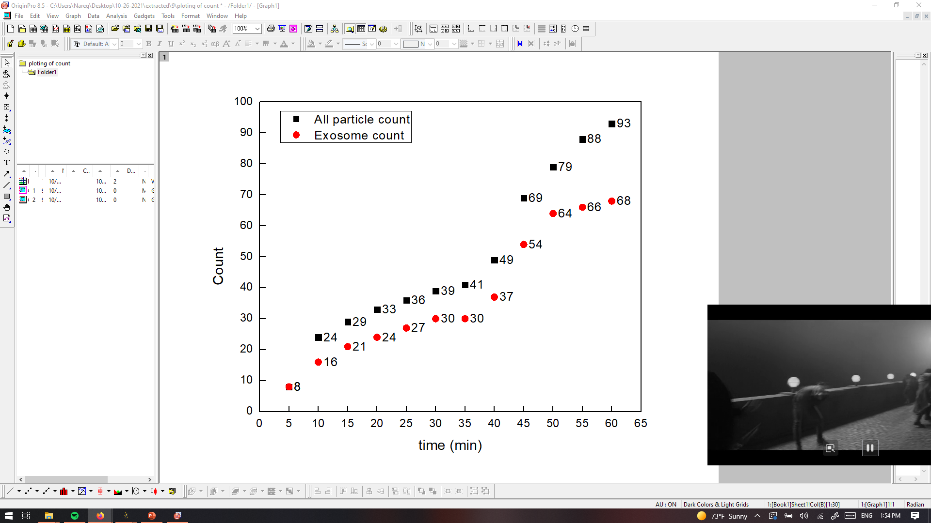
PANRORAMA of Plasma Sample 9 (Healthy)
Time: 60 min
Count: 93
Time: 60 min wash
Count: 46
Note: No response to miRNA-21 mb
Scale bar: 10 µm

Slide 18
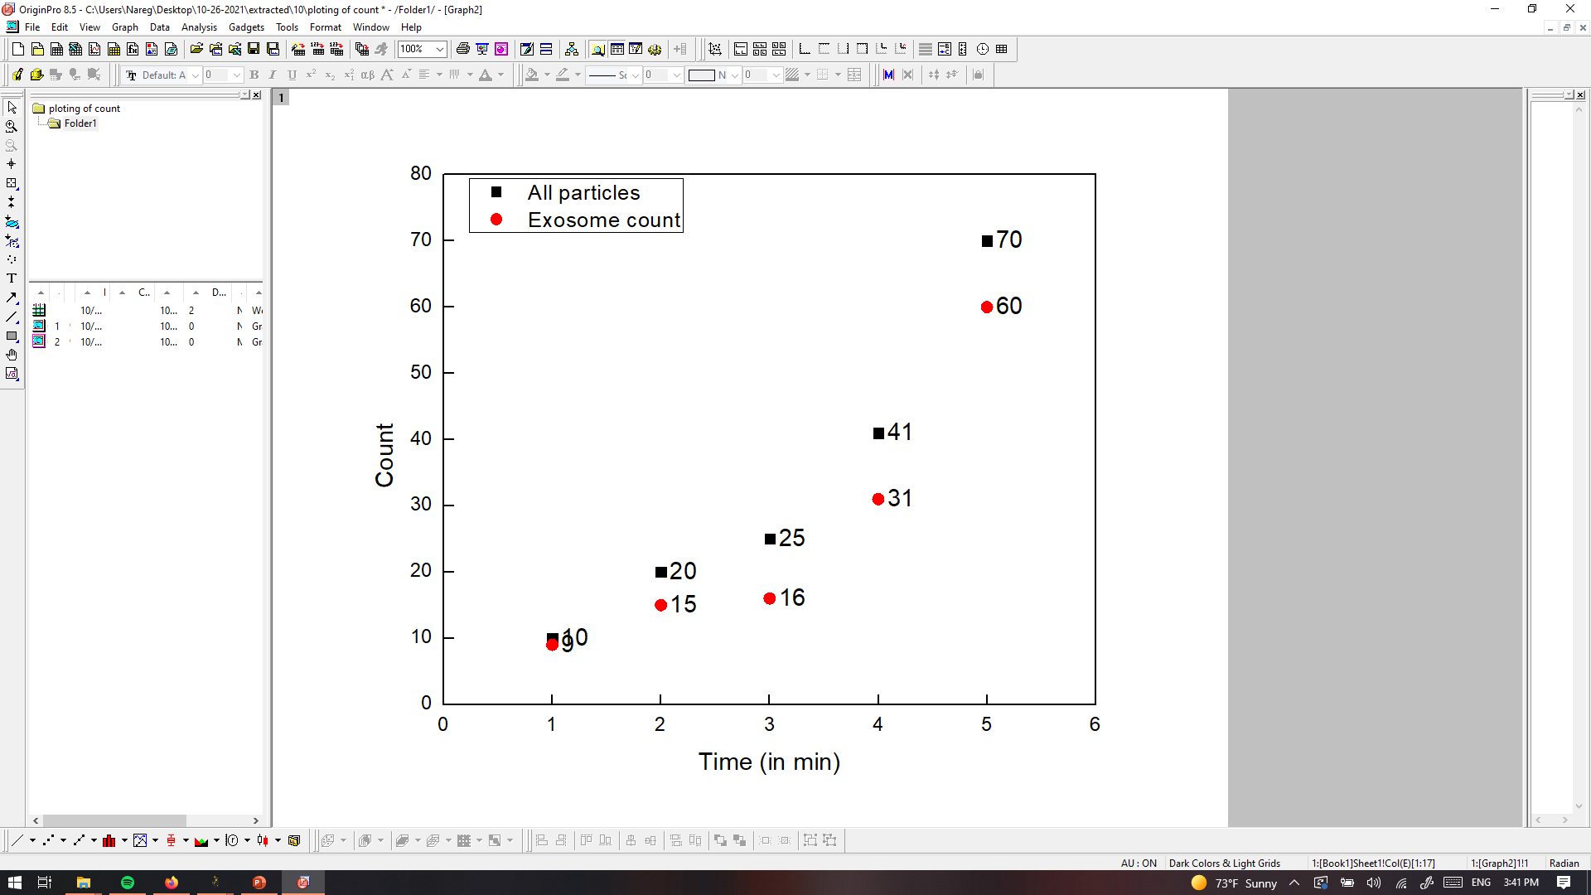
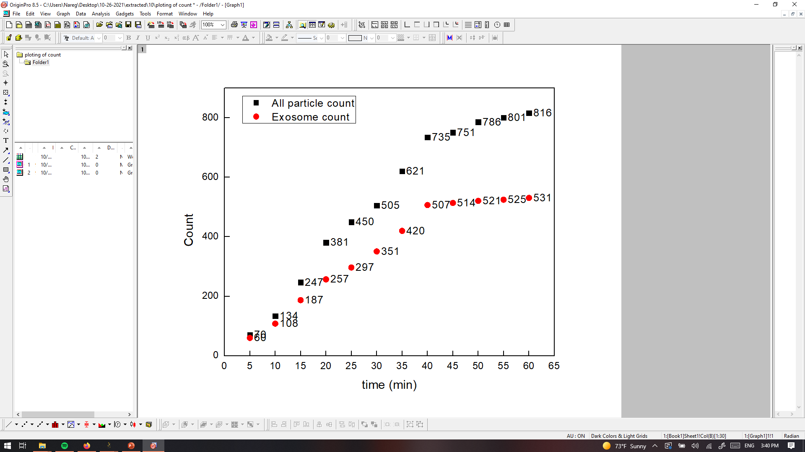
PANRORAMA of Plasma Sample 10 (Cancer)
Time: 10 min
Time: 20 min
Time: 30 min
Particle count at 5 min intervals
Time: 40 min
Time: 50 min
Time: 60 min
Scale bar: 10 µm

Slide 19
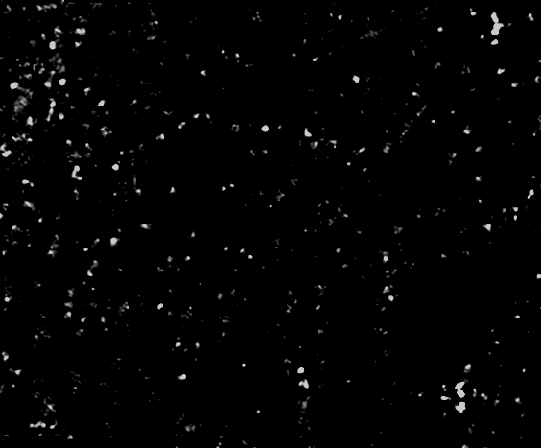
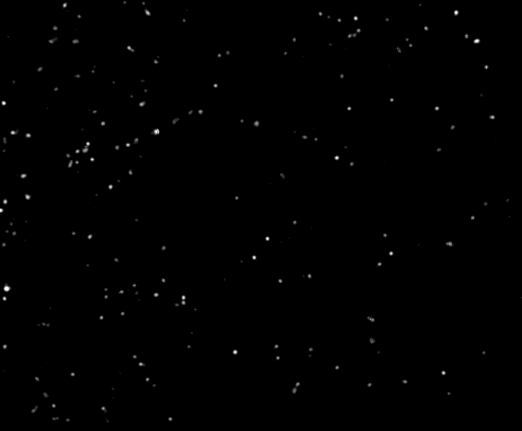
PANRORAMA of Plasma Sample 10 (Cancer)
Time: 60 min
Count: 816
Time: 60 min wash
Count: 208
Note: 4 % response to miRNA-21 mb
Scale bar: 10 µm

Slide 20
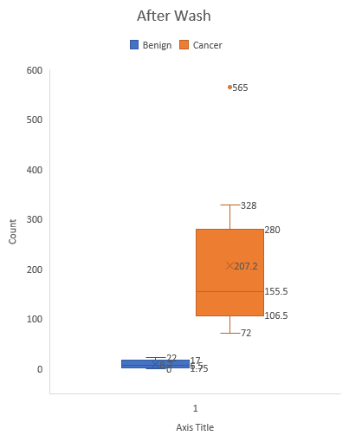
Count of attached exosomes for plasma samples and prediction
Sample | Count AW | Prediction
1 | 18 | Healthy
2 | 396 | Cancer
3 | 7 | Healthy
4 | 201 | Cancer
5 | 5 | Healthy
6 | 404 | Cancer
7 | 33 | Healthy
8 | 302 | Cancer
9 | 46 | Healthy
10 | 208 | Cancer

